Slide 1
Assignment 3
Solutions

Slide 2
Problem 1
Q. Find out the critical energy for Lead Tungstate.
Ans. 169.5 GeV (Source: CMS Collaboration 2010 JINST 5 P03007)
(Critical energy for Lead and Tungsten has been found in problem 7)

Slide 3
(Source: Particle Detectors by Claus Grupen and Boris Shwartz)
Proton-nucleus inelastic cross section data
(Source: The Astrophysical Journal Supplement Series, 51, 271-276,1983 March.
Title: Proton-Nucleus Inelastic Cross sections: An empirical formula for E>10 MeV.
Authors: John R Letaw, R. Silberg and C. H. Tsao) =

Slide 4
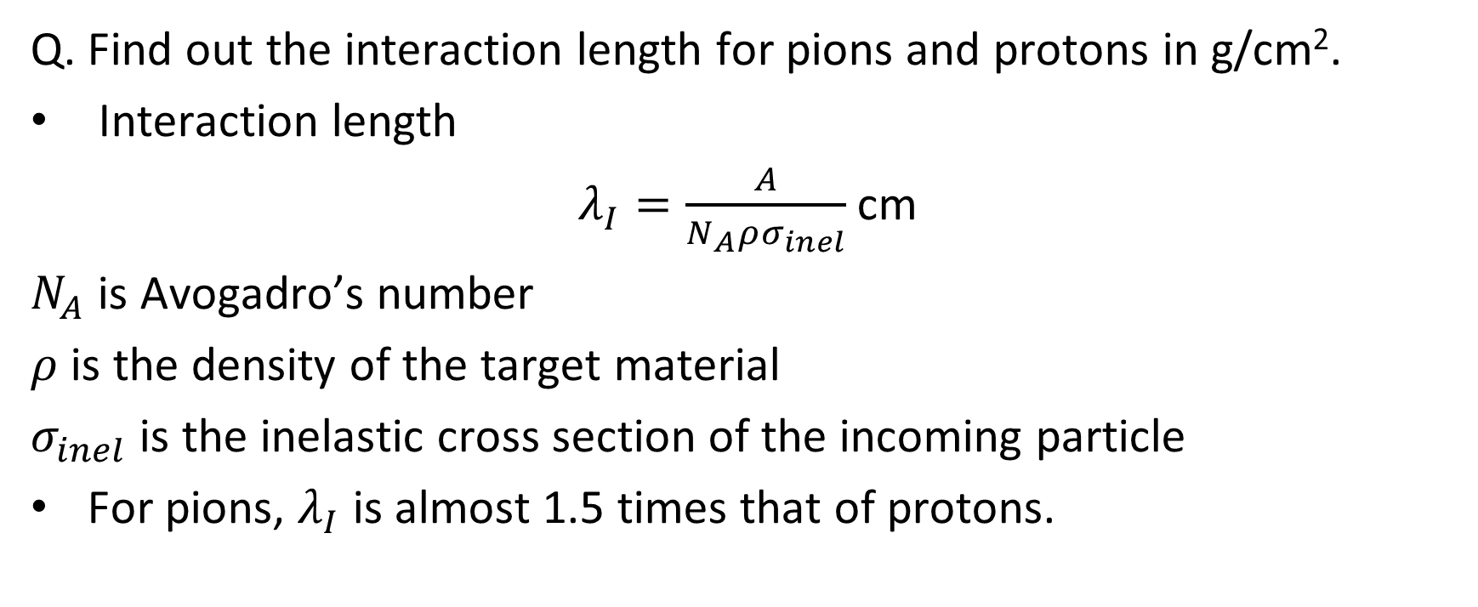
Problem 4
Q. Find out the interaction length for pions and protons in g/cm².
Interaction length
$λ_{I}=\frac{A}{N_{A}ρσ_{inel}}$ cm
$N_{A}$ is Avogadro’s number
$ρ$ is the density of the target material
$σ_{inel}$ is the inelastic cross section of the incoming particle
For pions, $λ_{I}$ is almost 1.5 times that of protons.

Slide 5
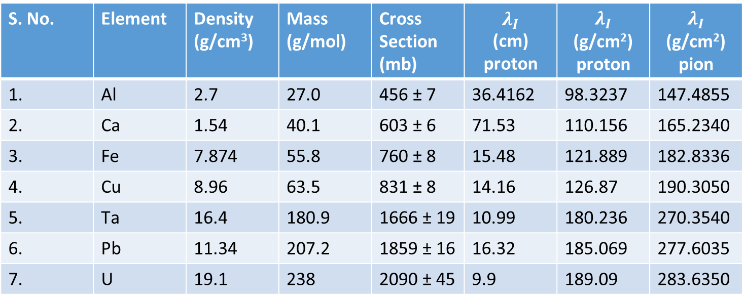
S. No. | Element | Density (g/cm³) | Mass (g/mol) | Cross Section (mb) | $$λ_{I}$$ (cm) proton | $$λ_{I}$$ (g/cm²) proton | $$λ_{I}$$ (g/cm²) pion
1. | Al | 2.7 | 27.0 | 456 ± 7 | 36.4162 | 98.3237 | 147.4855
2. | Ca | 1.54 | 40.1 | 603 ± 6 | 71.53 | 110.156 | 165.2340
3. | Fe | 7.874 | 55.8 | 760 ± 8 | 15.48 | 121.889 | 182.8336
4. | Cu | 8.96 | 63.5 | 831 ± 8 | 14.16 | 126.87 | 190.3050
5. | Ta | 16.4 | 180.9 | 1666 ± 19 | 10.99 | 180.236 | 270.3540
6. | Pb | 11.34 | 207.2 | 1859 ± 16 | 16.32 | 185.069 | 277.6035
7. | U | 19.1 | 238 | 2090 ± 45 | 9.9 | 189.09 | 283.6350

Slide 6
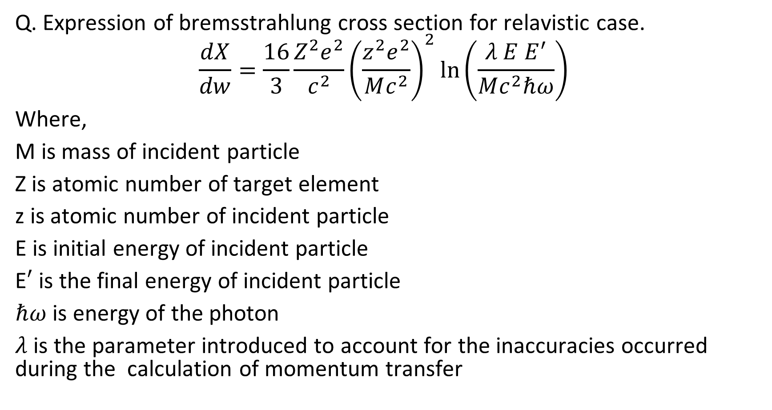
Problem 6
Q. Expression of bremsstrahlung cross section for relavistic case.
$$\frac{dX}{dw}=\frac{16}{3}\frac{Z^{2}e^{2}}{c^{2}}{\left(\frac{z^{2}e^{2}}{Mc^{2}}\right)}^{2}\ln\left(\frac{λ E E^{′}}{Mc^{2}ℏω}\right)$$
Where,
M is mass of incident particle
Z is atomic number of target element
z is atomic number of incident particle
E is initial energy of incident particle
E$′$ is the final energy of incident particle
$ℏω$ is energy of the photon
$λ$ is the parameter introduced to account for the inaccuracies occurred during the calculation of momentum transfer

Slide 7
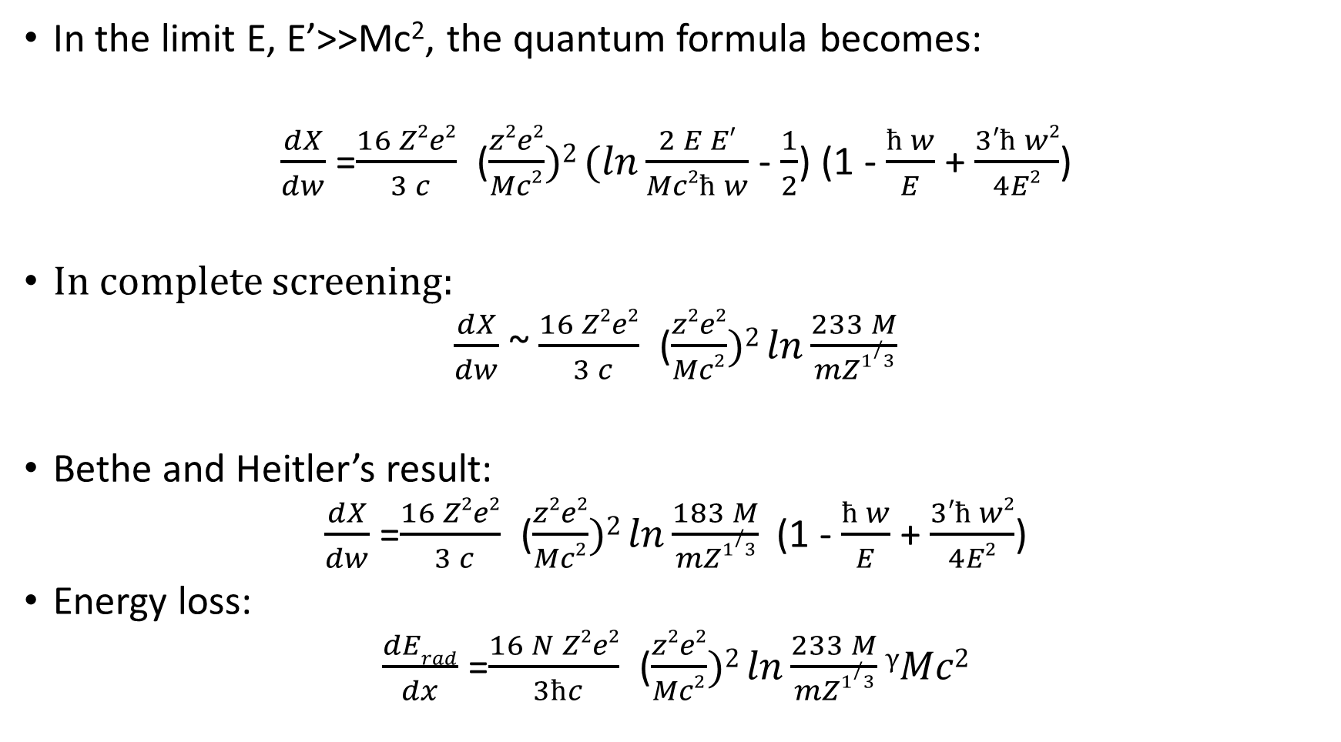

Slide 8
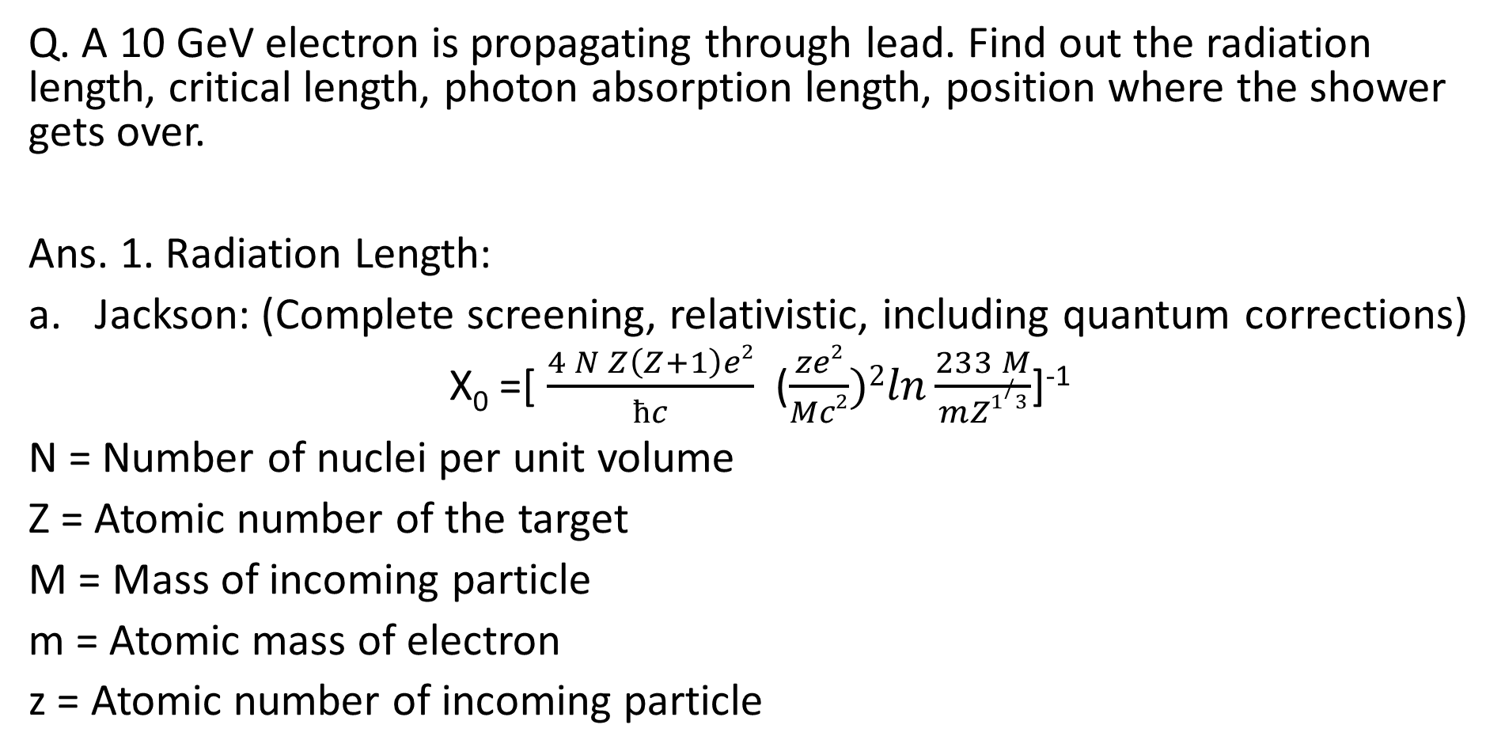
Problem 5

Slide 9
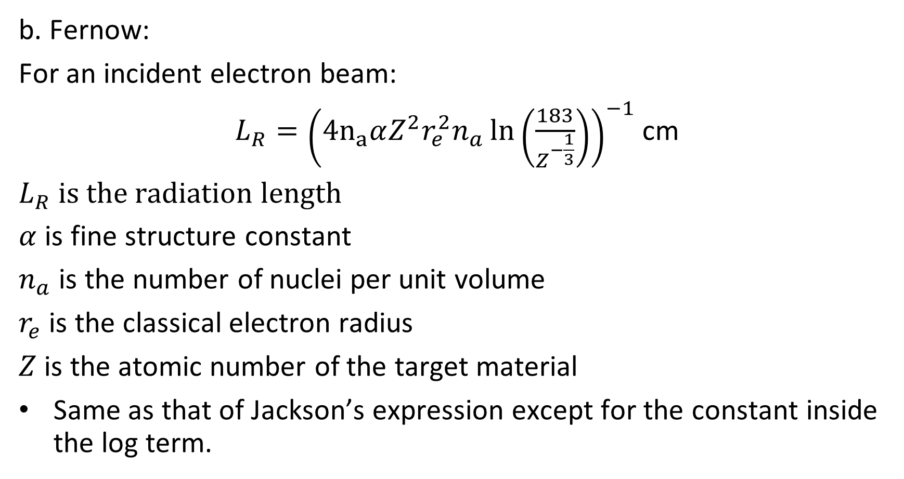
b. Fernow:
For an incident electron beam:
$L_{R}={\left(4n_{a}αZ^{2}r_{e}^{2}n_{a}\ln\left(\frac{183}{Z^{−\frac{1}{3}}}\right)\right)}^{−1}$ cm
$L_{R}$ is the radiation length
$α$ is fine structure constant
$n_{a}$ is the number of nuclei per unit volume
$r_{e}$ is the classical electron radius
$Z$ is the atomic number of the target material
Same as that of Jackson’s expression except for the constant inside the log term.

Slide 10
Radiation length of a few elements
S. No. | Element | Atomic Number | Density (g/cm³) | Mass (g/mol) | Fernow g/cm² (electron) | Fernow g/cm² (muon) | Jackson g/cm² (electron) | Jackson g/cm² (muon)
1. | Al | 13 | 2.7 | 27.0 | 26.4275 | 508324 | 23.2501 | 460531
2. | Ca | 20 | 1.54 | 40.1 | 17.1484 | 323768 | 15.4458 | 300738
3. | Fe | 26 | 7.874 | 55.8 | 14.4192 | 269051 | 13.1168 | 252632
4. | Cu | 29 | 8.96 | 63.5 | 13.307 | 247058 | 12.1457 | 232852
5. | Ta | 73 | 16.4 | 180.9 | 6.46974 | 114826 | 5.99892 | 110348
6. | Pb | 82 | 11.34 | 207.2 | 5.93379 | 104679 | 5.50671 | 100736
7. | U | 92 | 19.1 | 238 | 5.47075 | 95926.3 | 5.08046 | 92423.7

Slide 13
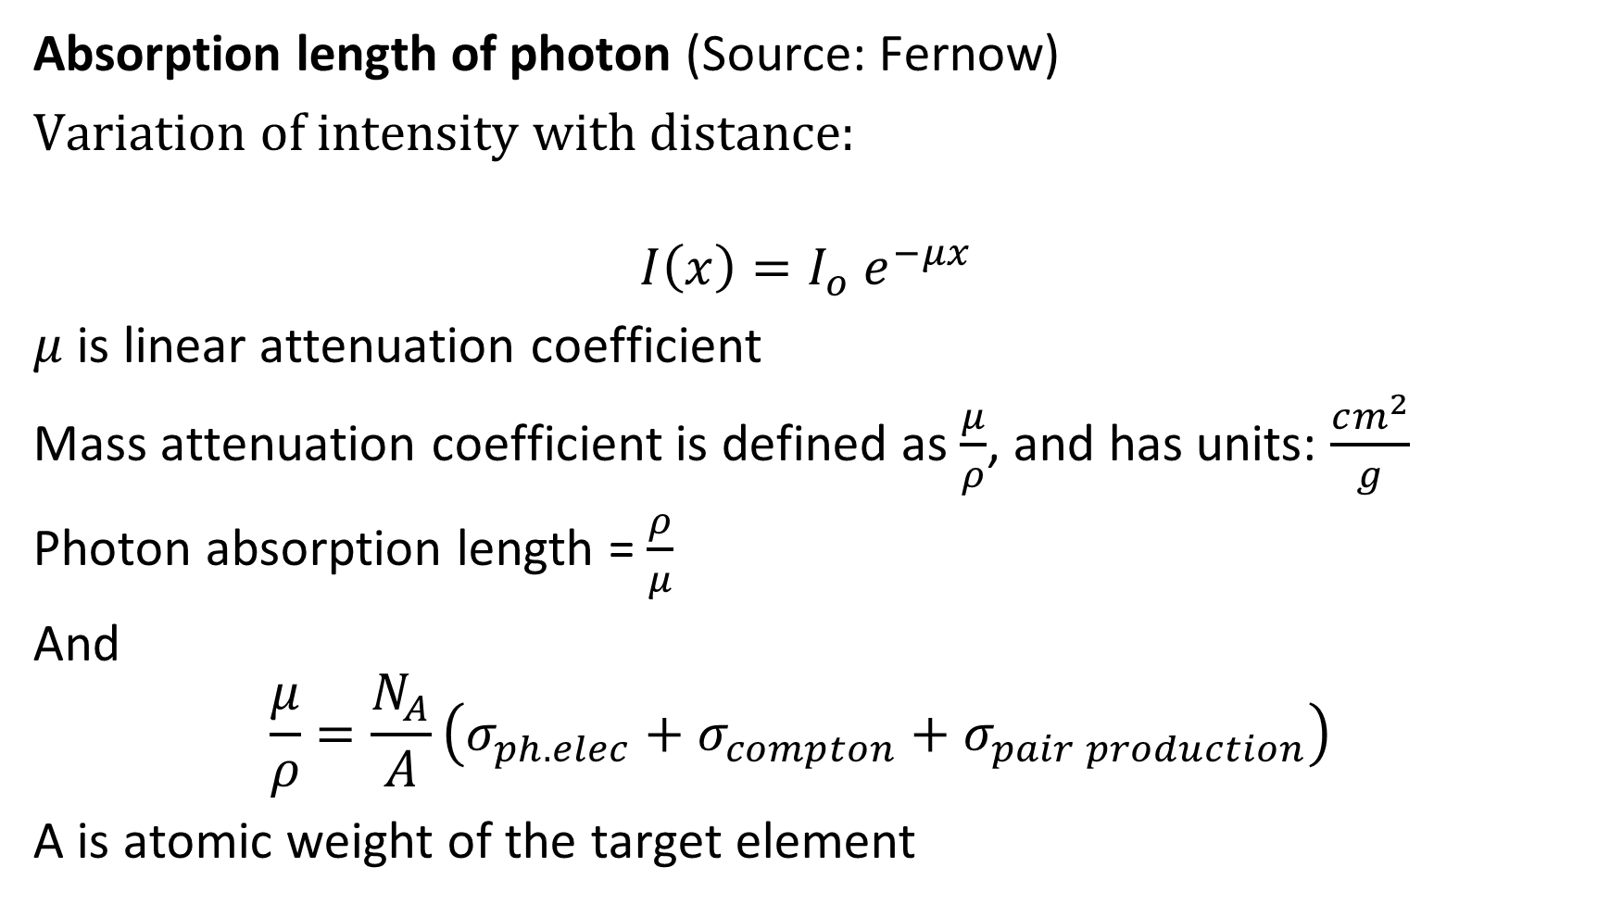
Absorption length of photon (Source: Fernow)
Variation of intensity with distance:
$$I\left(x\right)=I_{o} e^{−μx}$$
$μ$ is linear attenuation coefficient
Mass attenuation coefficient is defined as $\frac{μ}{ρ}$, and has units: $\frac{cm^{2}}{g}$
Photon absorption length = $\frac{ρ}{μ}$
And
$$\frac{μ}{ρ}=\frac{N_{A}}{A}\left(σ_{ph. elec}+σ_{compton}+σ_{pair production}\right)$$
A is atomic weight of the target element

Slide 14
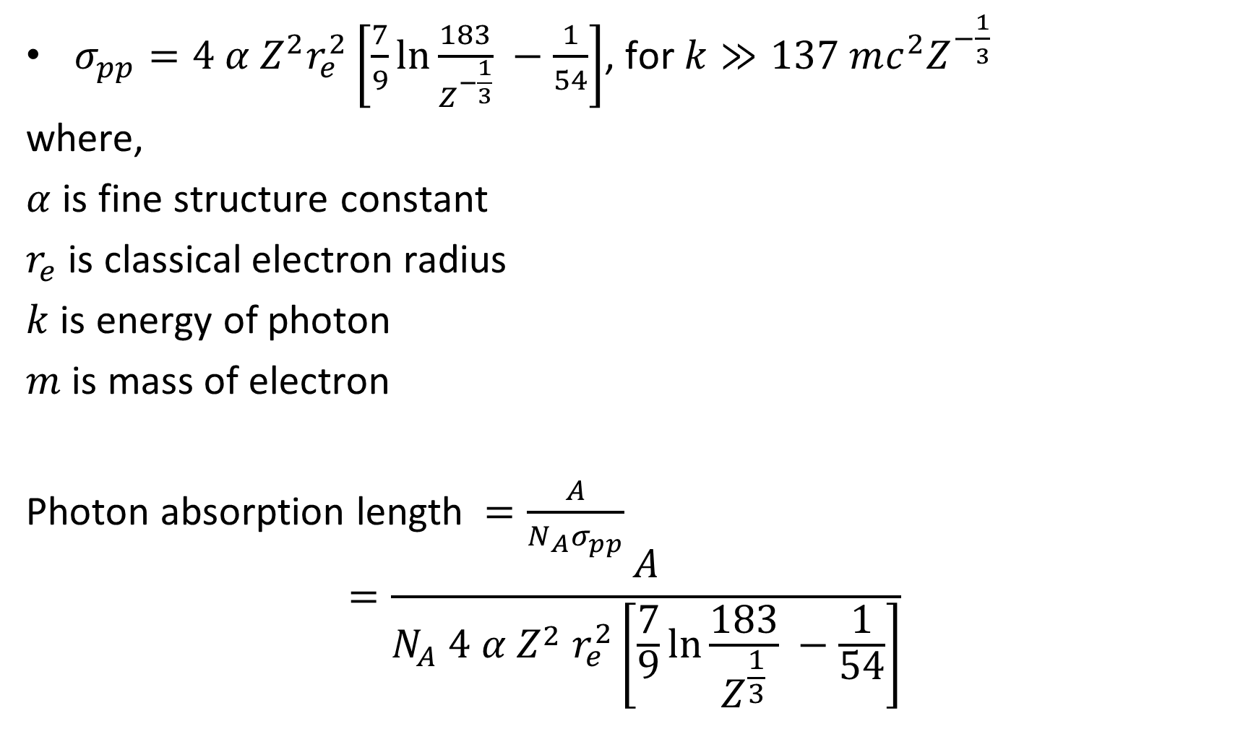
$σ_{pp}=4 α Z^{2}r_{e}^{2}\left[\frac{7}{9}\ln{\frac{183}{Z^{−\frac{1}{3}}}} −\frac{1}{54}\right]$, for $k≫137 mc^{2}Z^{−\frac{1}{3}}$
where,
$α$ is fine structure constant
$r_{e}$ is classical electron radius
$k$ is energy of photon
$m$ is mass of electron
Photon absorption length $=\frac{A}{N_{A}σ_{pp}}$
$$=\frac{A}{N_{A} 4 α Z^{2} r_{e}^{2}\left[\frac{7}{9}\ln{\frac{183}{Z^{\frac{1}{3}}}} −\frac{1}{54}\right]}$$

Slide 15
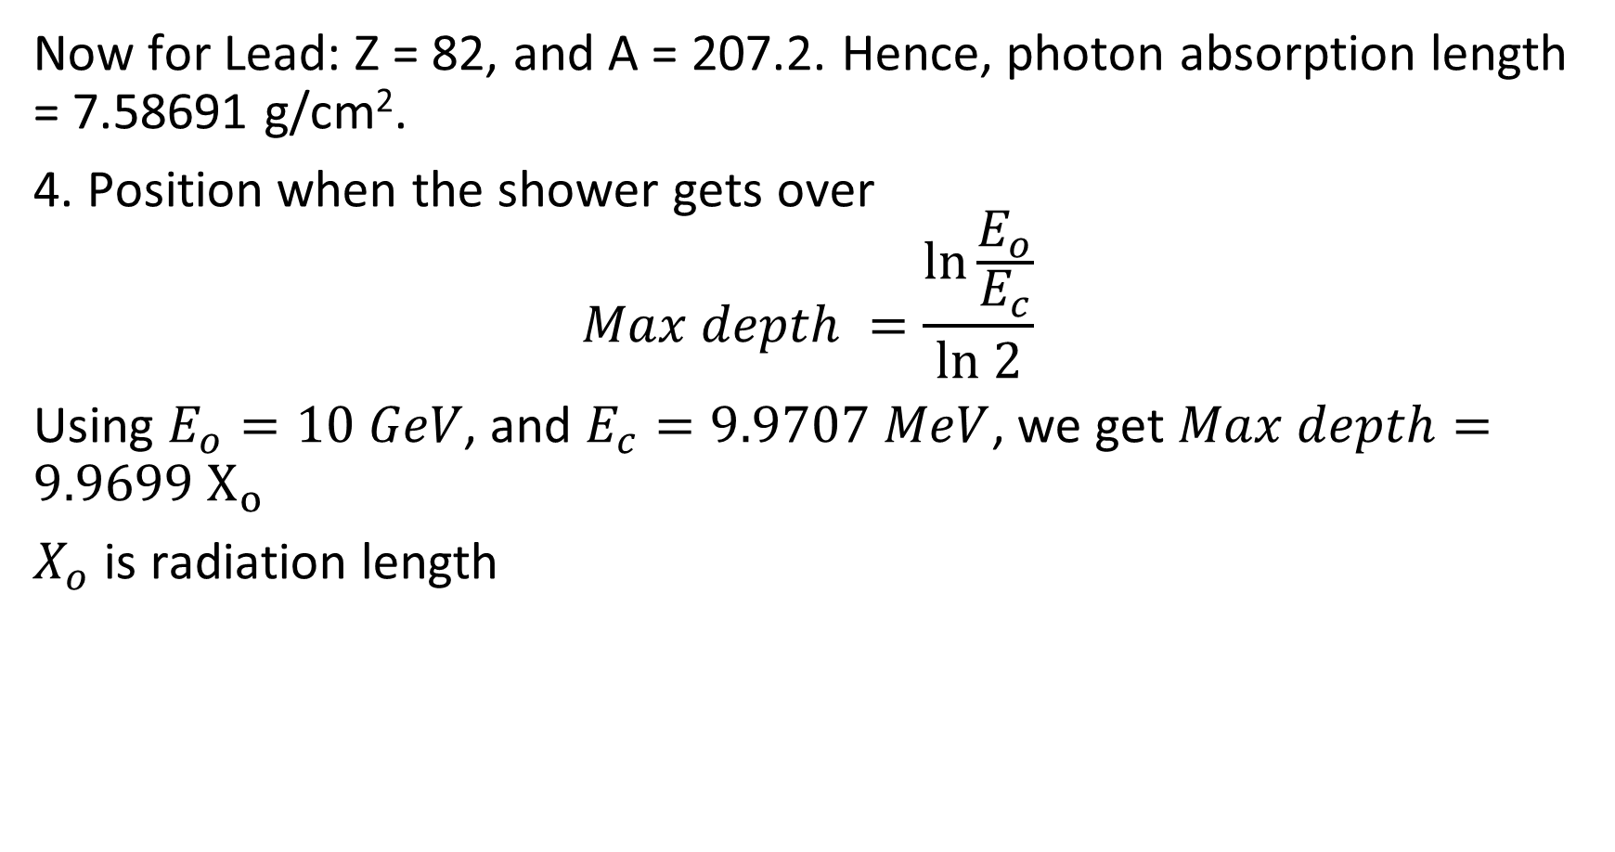
Now for Lead: Z = 82, and A = 207.2. Hence, photon absorption length = 7.58691 g/cm².
4. Position when the shower gets over
$$Max depth =\frac{\ln{\frac{E_{o}}{E_{c}}}}{ln 2}$$
Using $E_{o}=10 GeV$, and $E_{c}=9.9707 MeV$, we get $Max depth=9.9699 X_{o}$
$X_{o}$ is radiation length

Slide 16
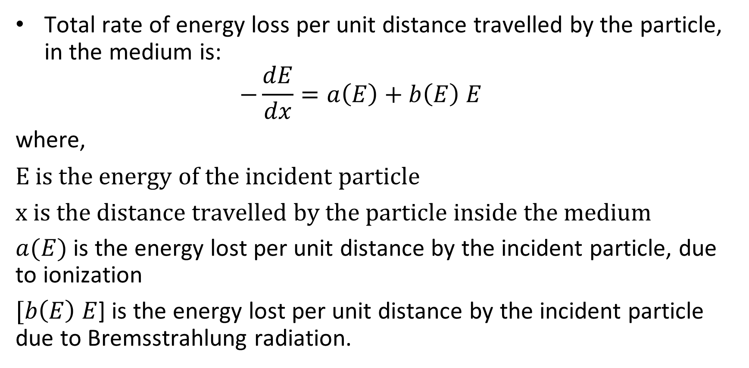
Critical Energy
Total rate of energy loss per unit distance travelled by the particle, in the medium is: $−\frac{dE}{dx}=a\left(E\right)+b\left(E\right) E$
where,
E is the energy of the incident particle
x is the distance travelled by the particle inside the medium
$a(E)$ is the energy lost per unit distance by the incident particle, due to ionization
$[b\left(E\right) E$] is the energy lost per unit distance by the incident particle due to Bremsstrahlung radiation.

Slide 17
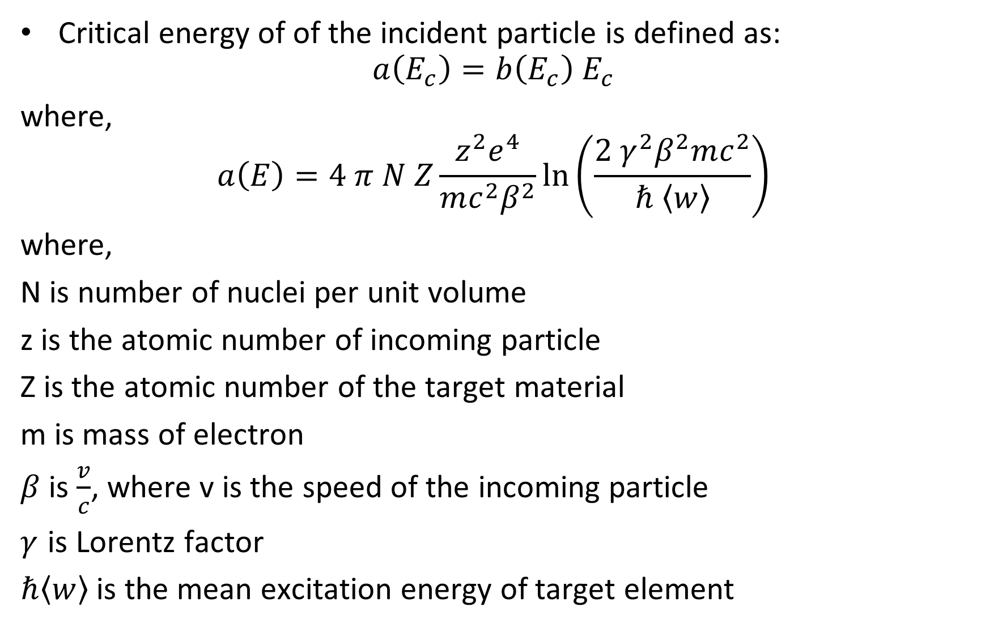
Critical energy of of the incident particle is defined as:
$$a\left(E_{c}\right)=b\left(E_{c}\right) E_{c}$$
where,
$$a\left(E\right)=4 π N Z\frac{z^{2}e^{4}}{mc^{2}β^{2}}\ln\left(\frac{2{ γ}^{2}β^{2}mc^{2}}{ℏ 〈w〉}\right)$$
where,
N is number of nuclei per unit volume
z is the atomic number of incoming particle
Z is the atomic number of the target material
m is mass of electron
$β$ is $\frac{v}{c}$, where v is the speed of the incoming particle
$γ$ is Lorentz factor
$ℏ〈w〉$ is the mean excitation energy of target element

Slide 18

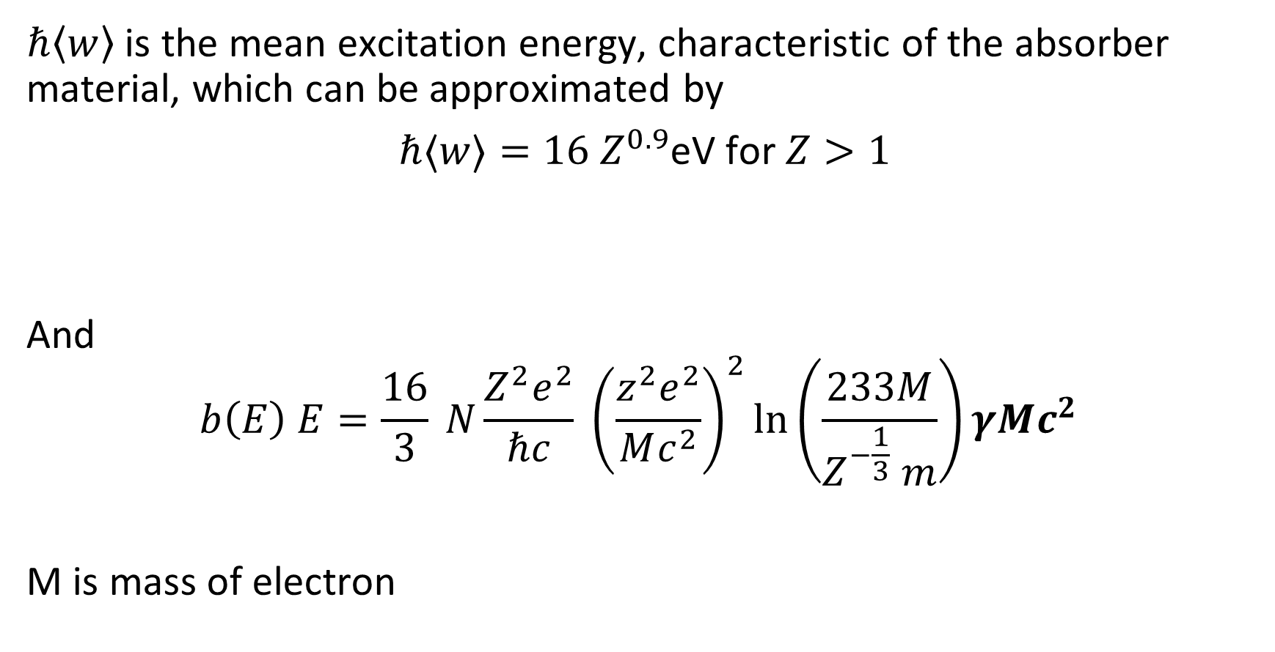
$ℏ〈w〉$ is the mean excitation energy, characteristic of the absorber material, which can be approximated by
$ℏ〈w〉=16 Z^{0.9}$eV for $Z>1$
And
$$b\left(E\right) E=\frac{16}{3} N\frac{Z^{2}e^{2}}{ℏc} {\left(\frac{z^{2}e^{2}}{Mc^{2}}\right)}^{2}\ln\left(\frac{233M}{Z^{−\frac{1}{3}} m}\right)γMc^{2}$$
M is mass of electron
Source: Particle detectors by Grupen and Schwartz
$$E$$
Source: Jackson, 3rd edition

Slide 19
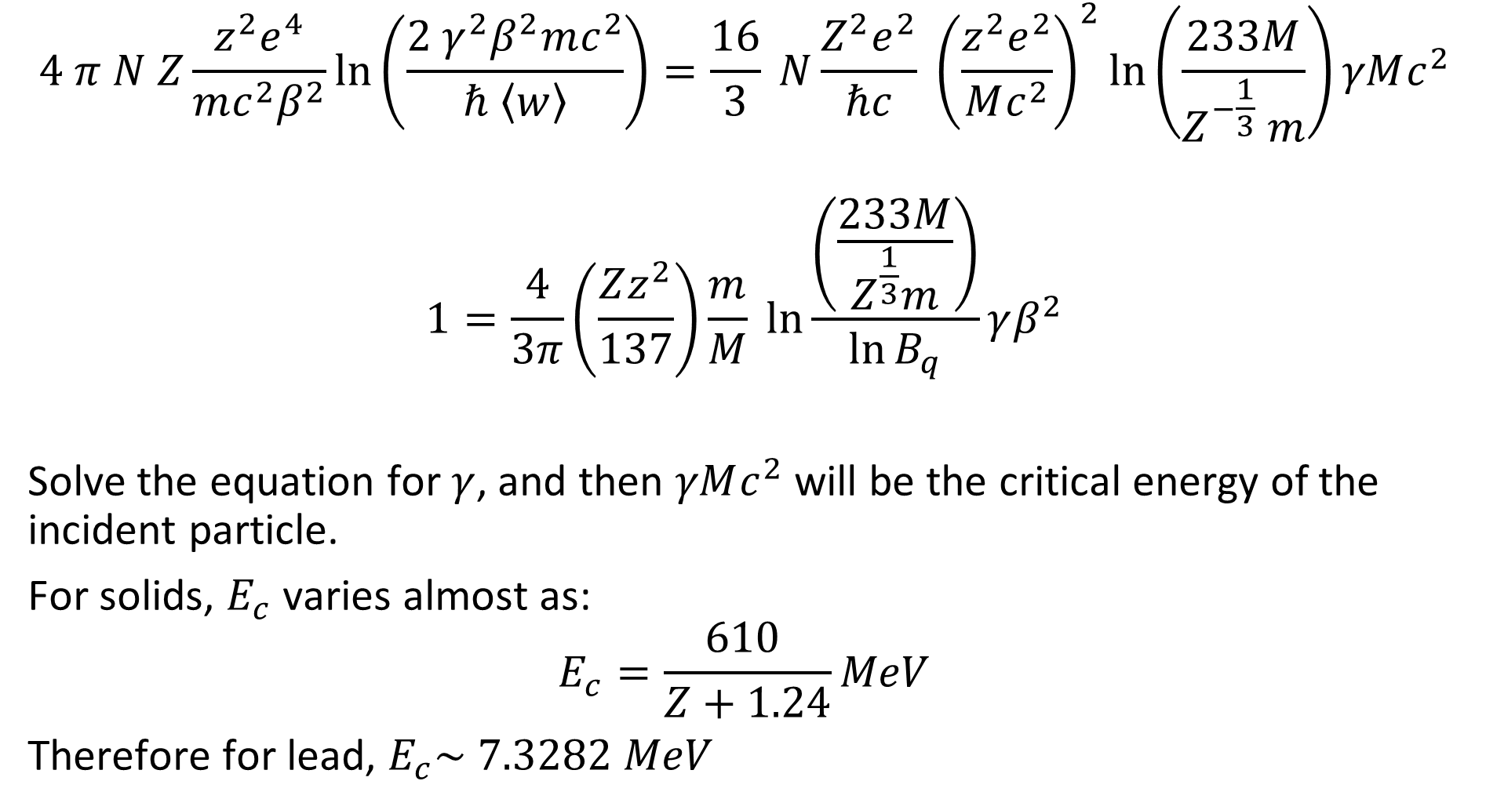
$$4 π N Z\frac{z^{2}e^{4}}{mc^{2}β^{2}}\ln\left(\frac{2{ γ}^{2}β^{2}mc^{2}}{ℏ 〈w〉}\right)=\frac{16}{3} N\frac{Z^{2}e^{2}}{ℏc} {\left(\frac{z^{2}e^{2}}{Mc^{2}}\right)}^{2}\ln\left(\frac{233M}{Z^{−\frac{1}{3}} m}\right)γMc^{2}$$
$$1=\frac{4}{3π}\left(\frac{Zz^{2}}{137}\right)\frac{m}{M}\ln{\frac{\left(\frac{233M}{Z^{\frac{1}{3}}m}\right)}{\ln{B_{q}}}}γβ^{2}$$
Solve the equation for $γ$, and then $γMc^{2}$ will be the critical energy of the incident particle.
For solids, $E_{c}$ varies almost as:
$$E_{c}=\frac{610 }{Z+1.24}MeV$$
Therefore for lead, $E_{c}\sim 7.3282 MeV$
Source: Particle Detectors by Grupen and Schwartz

Slide 20

Fernow:
$$E_{c}=\frac{1600mc^{2}}{Z}$$
For Lead, $E_{c}\sim 9.9707$

Slide 21

Problem 7
Q. Find out the critical energy for some materials for muon and electron.
Ans.
$$\frac{m_{μ}}{m_{e}}=206.76712$$
$$E_{μ}=E_{c}{\left(206.7612\right)}^{2}$$

Slide 22
S. No. | Element | Atomic number | E_{c} (electron) (MeV) Fernow | E_{c} (muon) (TeV) Fernow | E_{c} (electron) (MeV) Grupen & Schwartz | E_{c} (muon) (TeV) Grupen & Schwartz
1. | Si | 14 | 58.4 | 2.495133 | 40.0262 | 1.710115
2. | Pb | 82 | 9.9707 | 0.426286 | 7.3282 | 0.313096
3. | Al | 13 | 62.8923 | 2.687066 | 42.8371 | 1.830210
4. | Fe | 26 | 31.4462 | 1.343535 | 22.3935 | 0.956759
5. | Cu | 29 | 28.1931 | 1.204547 | 20.1719 | 0.861842
6. | Tungsten | 74 | 11.0486 | 0.472050 | 8.10739 | 0.346387

Slide 23
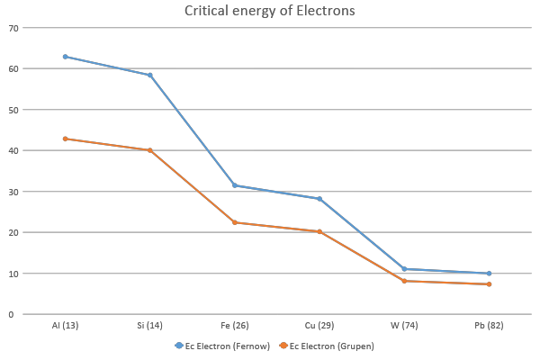

Slide 24
